Slide 1
Breaking Backbone.js myths w.r.t. myProjects/myOrder

Slide 2
Front-end development facts
Backbone facts and trends
Saltmarsh repo loc

Slide 3
Backbone basic concepts

Slide 4
MVC and Events

Slide 5
Backbone page rendering lifecycle

Slide 6
Backbone LayoutManager and more

Slide 7
Best Practices (Do’s and Dont’s)
The practise we follow is to
initialize the models/collection at initialization,
Fetch the data beforeRender,
and render the child-views afterRender.
Firstly we can not render in initialize, as the DOM i.e. $el of parent View will not be loaded at that time.
Then at Render, it should not be as if it is a chain i.e. to render a chain of child view within a child view then the top view’s rendering will take longer time till all its internal child views are not rendered.
So afterRender is a better option as this helps in keeping the UI more interactive, as rendering the complete view afterRender when data is completely fetched looks better to the User, rather than the scattered bits and pieces without data.
And it has advantages like we can display Loading screen on beforeRender till the data is not fetched and render the child view by removing the loading screen. And also gives us the advantage to animate the child view while rendering.
But, sometime is depends on the requirement as well, like you want to display the parent view only when child view is ready because it is the only view or it has dependency or access rights checking depending on which parent view has to update the DOM elements, then we will render the child view before rendering the parent view.

Slide 8
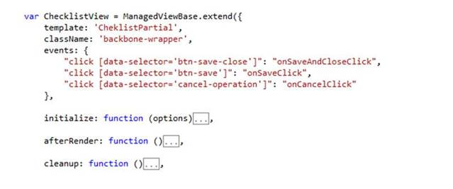
Best Practices (Do’s and Dont’s)
Proper structuring while creating new views in the application. There is no Impact on functionality but it is helpful in code maintainability.
class Name - name of the parent class of the view
events – view level events defined
initialize
serialize – if applicable place serialize in between initialize and afterRender
afterRender
<Other functions> - All other methods should place between afterRender and cleanup
cleanup – Cleanup should be always placed at the bottom of the file (if applicable)

Slide 9
Best Practices (Do’s and Dont’s)
Ideal practice : initialize the models/collection at initialization, Fetch the data beforeRender, and render the child-views in afterRender.
Use this.$el to access the DOM elements of your view.
afterRender is a the best place to render childViews as this helps in keeping the UI more interactive.
But, sometime is depends on the requirement as well, like you want to display the parent view only when child view is ready because it is the only view or it has dependency or access rights checking depending on which parent view has to update the DOM elements, then we will render the child view before rendering the parent view.
Issues faced by Leads in review related to Backbone, which must be avoided.
1. Tightly coupled views
a. Parent can directly access immediate child view, but vice versa should be done by raising events.
b. Child view cannot access html of parent view.
2. Clean API/Interface with respect to Backbone. (Only required members should be visible to the outside world, else they should be private)
3. No CSS/html the in backbone view.
4. Respect the Folder/File structure.
5. No direct styling in html
6. Naming, should be consistent. Sounds trivial, but due to many developers working on same codebase requires second thought before naming anything.
7. Common Functionalities should be in utility

Slide 10
Best Practices (Do’s and Dont’s)
Model vs ViewModel
v A Model manages the behaviour and data of the application domain.
v A ViewModel provides all the information necessary for a View to be rendered. The data it contains is created using data defined in the Model. The View reads the ViewModel and renders the output.
If a view is to be rendered using multiple models, then ViewModel provides a way to aggregate the information required for a View into a single object.
In reality, ViewModels are nothing more than a simple wrapper for your domain objects. A simple mapper can be used to go back and forth between ViewModels and domain models with ease.
Ideally we should always bind View to ViewModel and never to the domain models, even if it's a single object. Because it gives us flexibility to decorate ViewModels with UIHints and validations.
Just the same way your domain models are enriched with domain-specific rules and business logic, so should your ViewModels be enriched with UI-specific logic.
Reasons why sometimes there can be cases where we need ViewModel in Backbone:
1. Separation of concerns, thus leading to Loose coupling.
2. Security : One of the biggest advantages with View Models is removing security risks. Domain objects will most likely contain properties that the user should not be able to change. (e.g. property called IsAdmin)
3. Backbone.Model's are great for storing the state of your objects and persisting them back to your server. But as your Backbone.View's become more complex, it's useful to have a model to store all view related attributes. If you store view attributes on the same model as your persistence model, when you call .save() on that model, the view attributes will be sent to the server too.
Further reading:
- http://stackoverflow.com/questions/1939403/mvvm-viewmodel-vs-mvc-viewmodel

Slide 11
Architecture diagram (Component)

Slide 12
Thoughts
For now we have an ecosystem running in backbone.js framework.
Yes new work in being planned in ReactJS, but this work will require enhancement and maintenance.
So knowing these concepts is important.

Slide 13
Grunt workflow

Slide 14
Bonus – Javascript
Calculations
0.2 * 0.1
4.9 * 0.1

